Slide 1

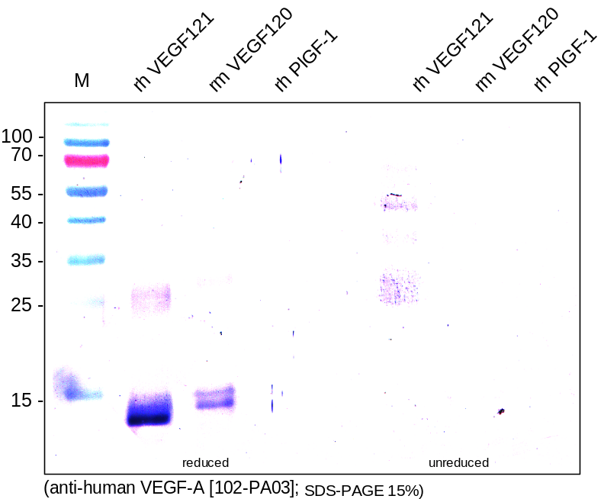
ReliaTech GmbH
Rabbit anti-human VEGF-A (peptide antibody)
(Cat #102-PA03)
Figure 1. Western analysis of recombinant human VEGF121 [Cat# 300-072], mouse VEGFG120 [Cat# M30-032] and human PlGF-1 [Cat# 300-015] using a rabbit polyclonal anti-human VEGF-A antibody [Cat# 102-PA02]. There is a cross reactivity with mouse VEGF120 visible but not with human PlGF-1. The antibody shows only a weak signal for unreduced human VEGF121.
http://www.reliatech.de / orders@reliatech.de

